Slide 1
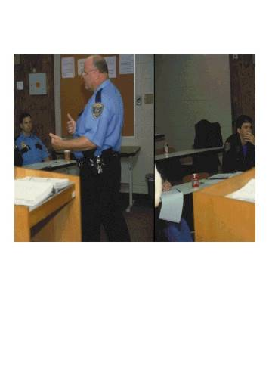
Session 1
Introduction and Overview

Slide 2

Drug Recognition Expert
7-Day School

Slide 3
Learning Objectives
State objectives and goals of the course
Outline major course content
Outline schedule of major course activities
Outline Participant Manual content and organization
Recognize course administrative matters

Slide 4

Housekeeping
Paperwork
Mandatory attendance
Breaks
Facility
Interruptions
All electronic devices off

Slide 5

Participant Introductions
Name
Agency affiliation
Experience

Slide 6
Drug Recognition Expert (DRE) Certification Phases
DRE Pre-School
DRE 7-Day School
Field Certification

Slide 7
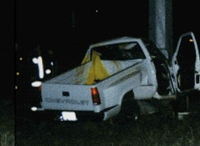
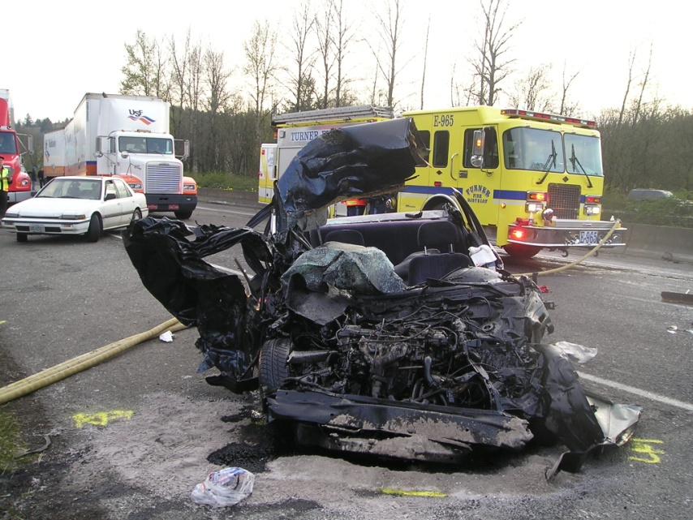
Course Goal
Prevent crashes, deaths and injuries caused by drug-impaired drivers

Slide 8


Slide 9
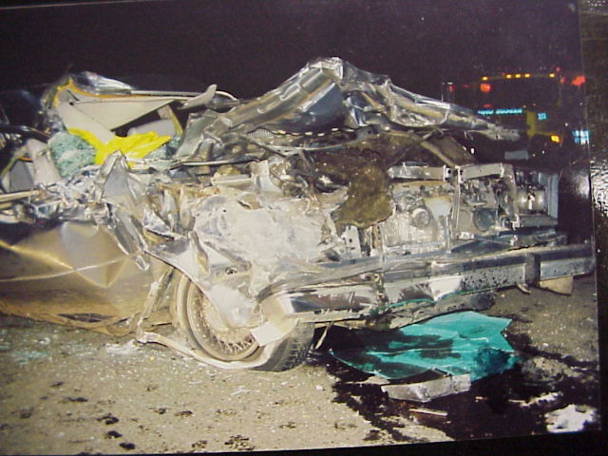
Incidence of Drug-Impaired Driving
California - A study of young male drivers fatally injured in crashes found 51% had used drugs other than alcohol

Slide 10
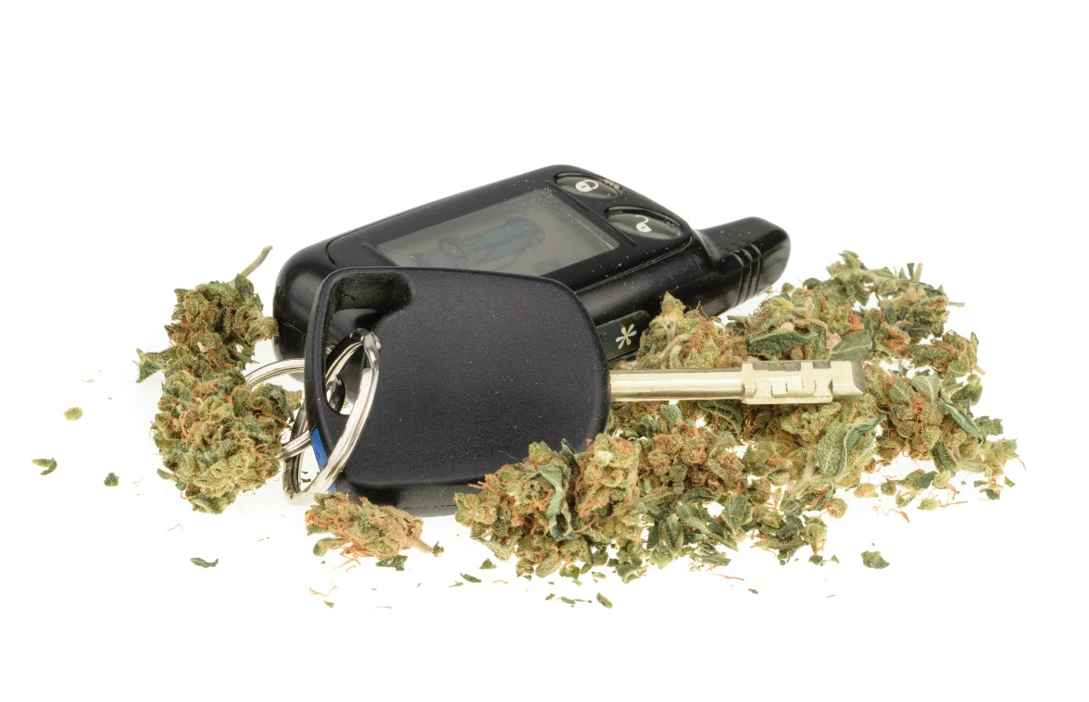
Drugged-Driving Incidence
Maryland Shock Trauma Center Study (1985-1986)
32% of drivers treated at the Shock Trauma Center had used marijuana prior to their crashes

Slide 11
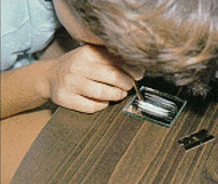
University of Tennessee Study (1988)
40% of drivers receiving emergency treatment had used drugs prior to the crash

Slide 12
Washington State (2006)
Results of blood and/or urine tests from 370 fatally-injured drivers :

Slide 13
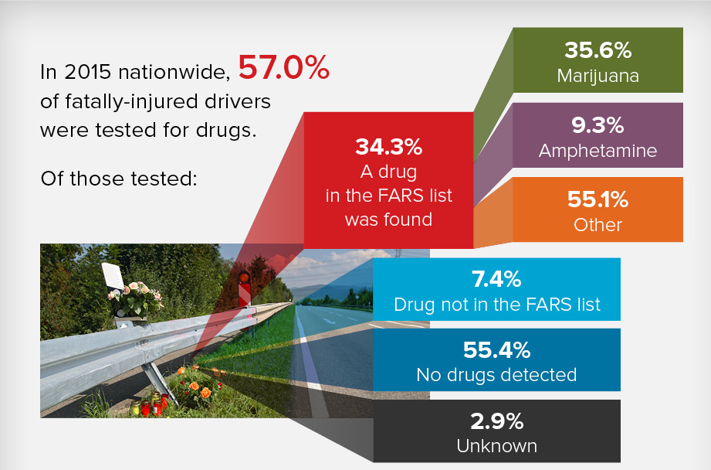

Slide 14
Drugged-Driving Incidence
2013:
12% of high school seniors admitted driving under the influence of Marijuana within the past two weeks
9.9 million persons age 12 or older reported driving under the influence of illicit drugs

Slide 15
DEC Program
Based on solid medical and scientific facts
Laboratory and field research
Elite international program
Share information
Maintain quality

Slide 16
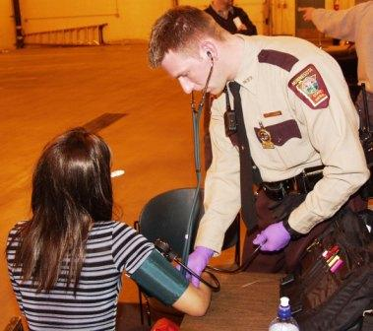
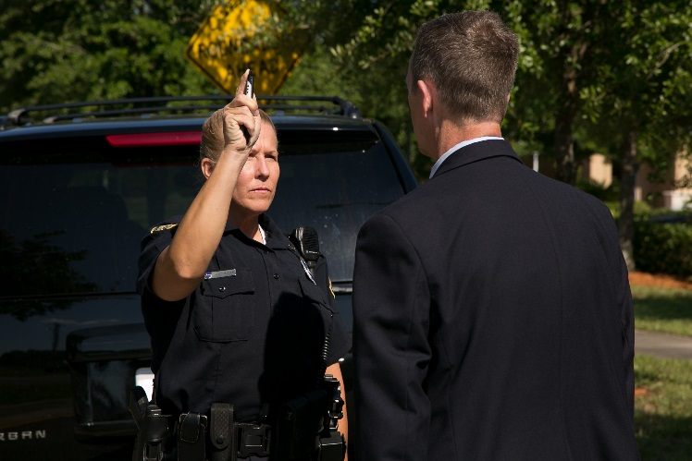
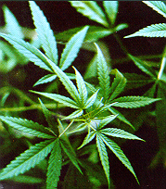
Classroom Training Goals

Slide 17

Classroom Training Objectives
Describe involvement of drugs in impaired-driving incidents
Name the seven drug categories and recognize their effects
Describe and properly conduct the drug influence evaluation
Document results of the drug influence evaluation

Slide 18
Classroom Training Objectives
Properly interpret the results of the evaluation
Prepare a narrative for the Drug Influence Report
Discuss appropriate procedures for testifying in typical DRE cases
Prepare and maintain a relevant and up-to-date Curriculum Vitae (CV)

Slide 19
Training Content
Drugs in society and vehicle operation
Development and effectiveness of the DEC Program
Overview of the DEC Program procedures
Eye examinations
Physiology and drugs
Vital signs examinations
The seven categories of drugs

Slide 20
Training Content
Drug reference sources
Interviewing suspects
CV Preparation and Maintenance
Case preparation and testimony
Classifying a suspect

Slide 21
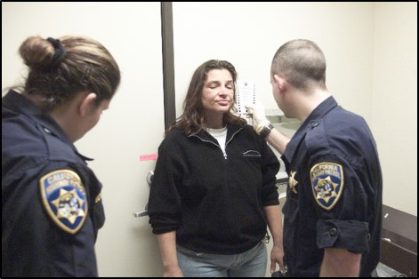
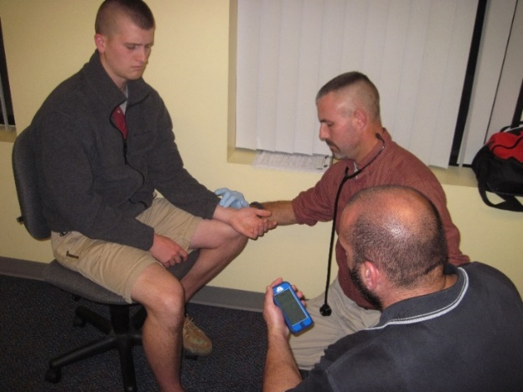
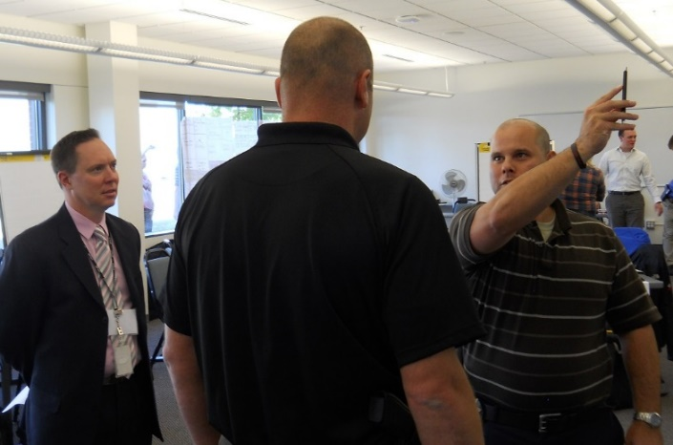
Training Activities

Slide 22

Participant Guide
Basic course reference
Class notes for every session
Guide organization
Preview sessions in advance
Review prior to exam

Slide 23

Criteria for Passing
Numerous quizzes
Written test: Score 80% or better to progress to the certification phase
80%

Slide 24
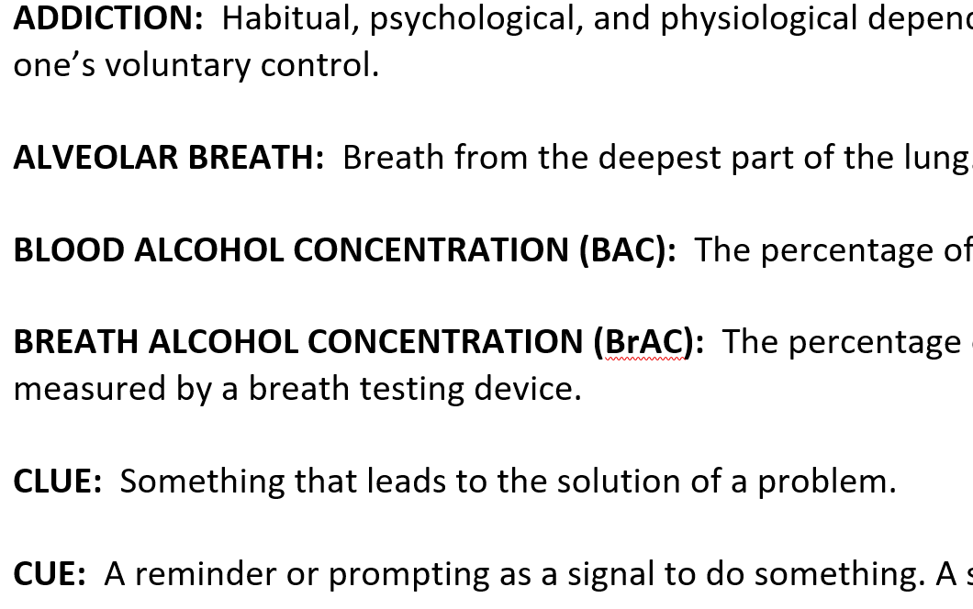

Glossary of Terms

Slide 25
Questions and Pre-test

